Slide 1
هوش محاسباتی:
شبکه های عصبی مصنوعی
دانشكده مهندسي كامپيوتر
دانشگاه علم و صنعت ايران
ناصر مزيني mozayani@iust.ac.ir
مدلهای بازگشتي

Slide 2
Recurrent networks

Slide 3
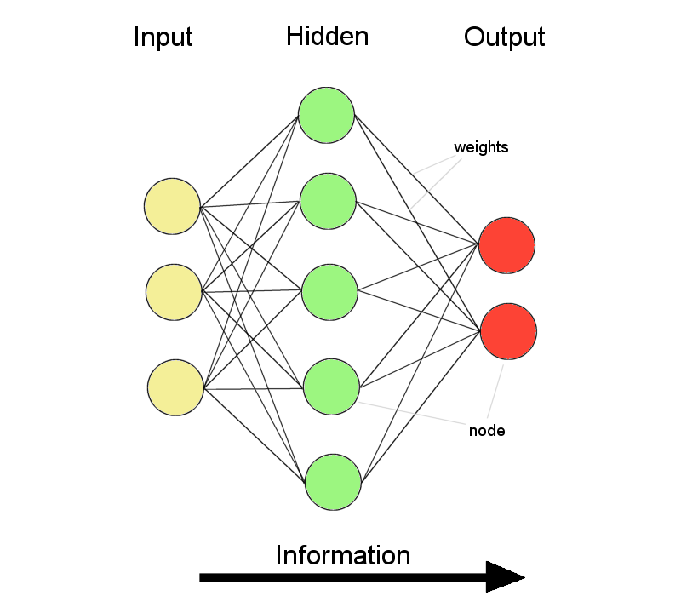
Introduction
Feed forward networks:
  Information only flows one way
  One input pattern produces one output
  No sense of time (or memory of previous state)
Recurrency
  Nodes connect back to other nodes or themselves
  Information flow is multidirectional
  Sense of time and memory of previous state(s)
Biological nervous systems show high levels of recurrency (but feed-forward structures exists too)

Slide 4
Introduction
Inspired from biology
Common features:
  Nonlinear processing units
  Many feedback connections
Most common models:
  Partially connected
    Elman Network
    Jordan Network
    LSTM
  Fully connected
    Hopfield Network
    Boltzman machine
    Mean-Field-Theory machine
    BSB

Slide 5
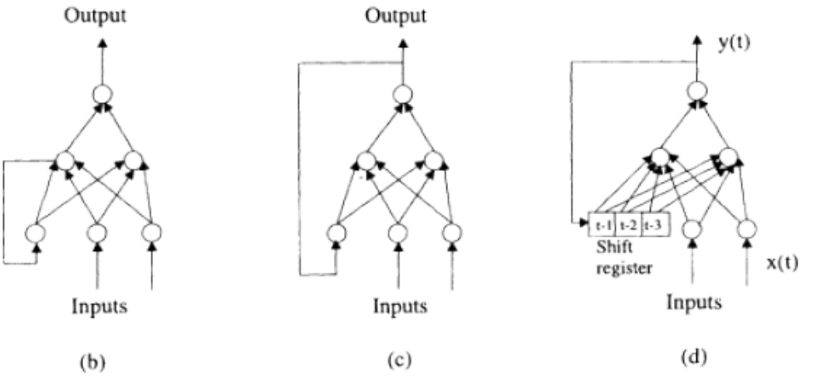
Introduction
  Partially connected
  Elman
  Jordan

Slide 6
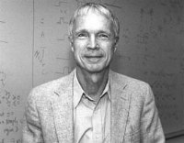
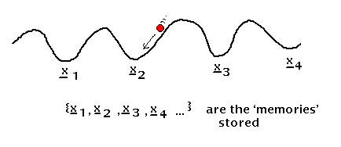
Hopfield model
Inspired from Physics
unsupervised
Dynamic interactive behaviour
Natural learning protocols

Slide 7
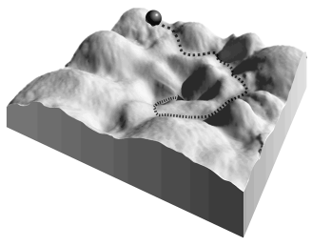
Hopfield model
Attractors
1D cross-section of energy landscape

Slide 8
Hopfield Model
j
w_{ij}
The restrictions imposed on the recurrent net are now:
All connections are symmetric w_{ij} = w_{ji}
No self-connectedness
w_{ji}
“Gerard Toulouse has called Hopfield’s use of symmetric connections a ‘clever step backwards from biological realism’. The cleverness arises from the existence of an energy function.”
i
w_{ii}=0
We will now see why having such an energy function provides us with:
A formalism of the process of memory storage and recall
A tool to visualise the activity (both learning and recall)
A straightforward way to train the net
Once trained, a guaranteed solution (recall of the correct memory).

Slide 9
Hopfield model
Network Architecture:
u₁
x₁
Σ
f( )
s₁
w₁₂
w_{1n}
w₂₁
u₂
x_{i}
x₂
Σ
f( )
s₂
.
.
.
.
.
.
w_{n1}
w_{n2}
u_{n}
x_{n}
Σ
f( )
s_{n}

Slide 10
How Does It Work?
-Every node is modelled by a conventional binary McPitts neuron.
-Each neuron serves both as an input and output unit. (There are no hidden units.)
-Each state is given by the pattern of activity of the neurons (e.g. 101 for a network with three neurons). Therefore, the number of neurons in the net sets the maximum length for a bit-string to be remembered.
-Different patterns can be simultaneously stored in the network weights.

Slide 11
How Does It Work?
-The number of independent patterns or words that can be remembered is less than or equal to the number of nodes in the net.
-Memory recall corresponds to a trajectory taking the system from some initial state (input) to the local energy minimum (closest association) .
-Each step along the (recall) trajectory results in the same or lower energy.
-Since energy is bounded from below, a solution is guaranteed for every input.

Slide 12
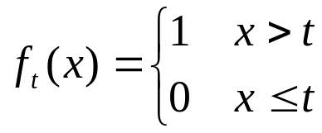
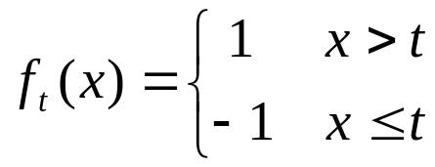
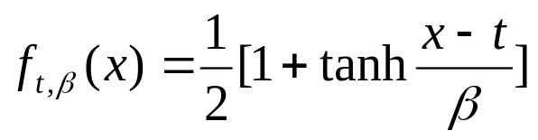
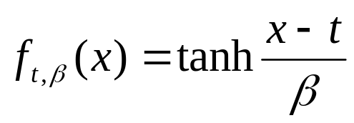
Activation function
f( ) can be
Binary valued hard limiter {0, 1}
Bipolar valued hard limiter {-1, 1}
Binary sigmoid [0, 1]
Bipolar sigmoid [-1, 1]

Slide 13
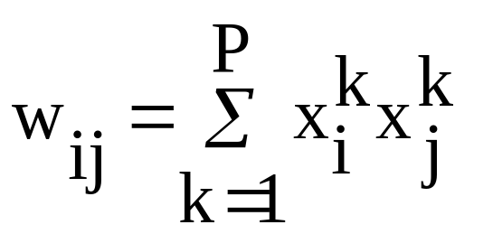
Hopfield Network
  Network Model and Operation
      The formal McCulloch-Pits neuron
      One of the two definite states “on” or “off”
      Synaptic connection w_{ji} between neuron i and j, determines the contribution of output x_{i} of neuron i to activation potential of neuron j
      Weights determined according to a Hebbian rule:

Slide 14


Network relations
  Network dynamics is determined by some differential equations:
  An energy function is defined (Liapunov):

Slide 15
Associative memory
  Retrieval of a stored pattern
      Update of a randomly selected neuron
      This asynchronous approach continues till there will not be any available neuron for state changes
  Associative memory model
      Network should memorize the most resembling one of a set of P patterns while a pattern is presented to its input
      Resembles = Hamming distance
      Content-addressable structure or autoassociative
      Robustness against to small errors in the input patterns
      Recognition and reconstruction of images, and retrieval of data with incomplete information

Slide 16
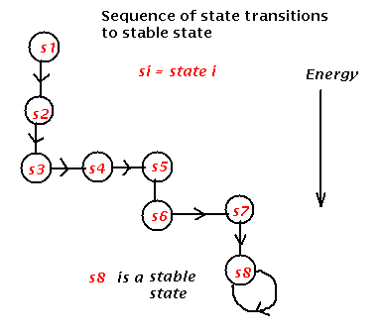
Associative memory

Slide 17
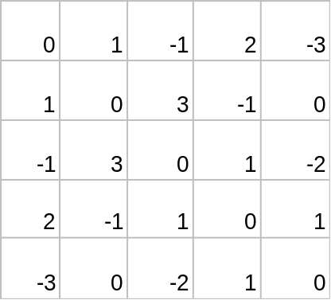
Simple example
1
2
3
4
5
Weight matrix
Input (t=0)
0 1 0 0 0
1 2 3 4 5 (neuron i)
t=1
1
1
1
0
1
t=2
0 1 1 1 0
t=3
1 1 1 1 0
1 1 1 1 0
t=4
1 1 1 1 0
(neuron j)
...
5 4 3 2 1
t
1 1 1 1 0
Σ x_{i} w_{ij}
1
0
3
-1
0
_{i}
-3 4 0 3 -5
2 2 4 0 -1
threshold = 0
2 3 3 2 -4
The stable pattern represents a fixed point in the dynamics. While stable solutions are guaranteed, in fact, not all stable solutions are fixed point solutions.
Exercise: repeat this example with an initial input of [ 0 1 0 1 0 ].
Note: this example used a “synchronous updating” method. Asynchronous (sequential or random) updating methods can also be implemented.

Slide 18
Associative memory
Concept:
  Object or pattern A (input) reminds the network of object or pattern B (output)
Hetero-associative Vs. auto-associative memories
  If A and B are different, the system is called hetero-associative net
  If A and B are the same, the system is called auto-associative net
A
A
Auto-association:
memory
Hetero-association:
memory
Waterfall
Niagara

Slide 19
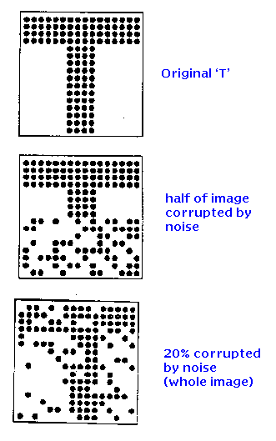
Associative memory

Slide 20
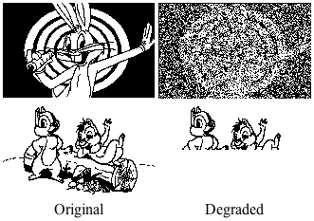
Hopfield Networks

Slide 21
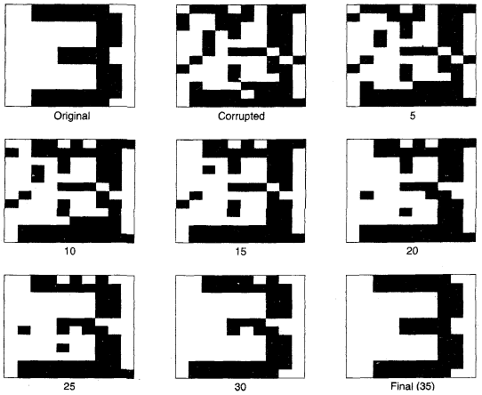
Pattern retrieval

Slide 22

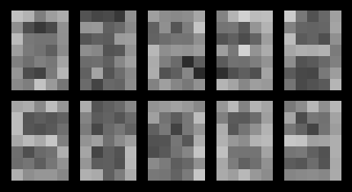
Hopfield Networks

Slide 23
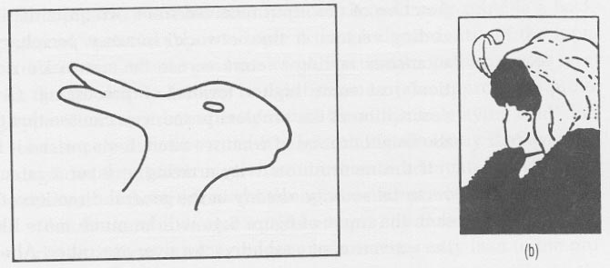
Hopfield Nets in the Brain??
The cerebral cortex is full of recurrent connections, and there is solid evidence for Hebbian synapse modification there. Hence, the cerebrum is believed to function as an associative memory.
Flip-flop figures indicate distributed hopfield-type coding, since we cannot hold both perceptions simultaneously (binding problem)

Slide 24
Some properties for Hopfield
Capacity C= the maximum number of patterns that can be stored without unacceptable error
C=N/4lnN (Weisbuch and Fogelman-Soulie 1985)
The network contains some spurious attractors (local minima of the energy)
    Reversed sign
    A linear combination of true patterns – mixture states
      All starting patterns with more that half the bits different from the original one will end up in reverse state
      Used for optimization problems

Slide 25
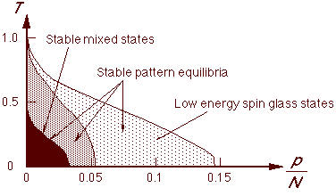
Phase diagram

